Slide 1
Set Operations and Joins
Presented by: Ayesha khan

Slide 2

SQL Wildcards
A wildcard character can be used to substitute for any other character(s) in a string.
In SQL, wildcard characters are used with the SQL LIKE operator.
SQL wildcards are used to search for data within a table.

Slide 3
SQL Wildcards
Wildcard | Description
_ (underscore) | matches any single character
% | matches a string of one or more characters
[ ] | matches any single character within the specified range (e.g. [a-f]) or set (e.g. [abcdef]).
[^] | matches any single character not within the specified range (e.g. [^a-f]) or set (e.g. [^abcdef]).

Slide 4
SQL Wildcards
SELECT * FROM Customers WHERE City LIKE '_erlin';

Slide 5
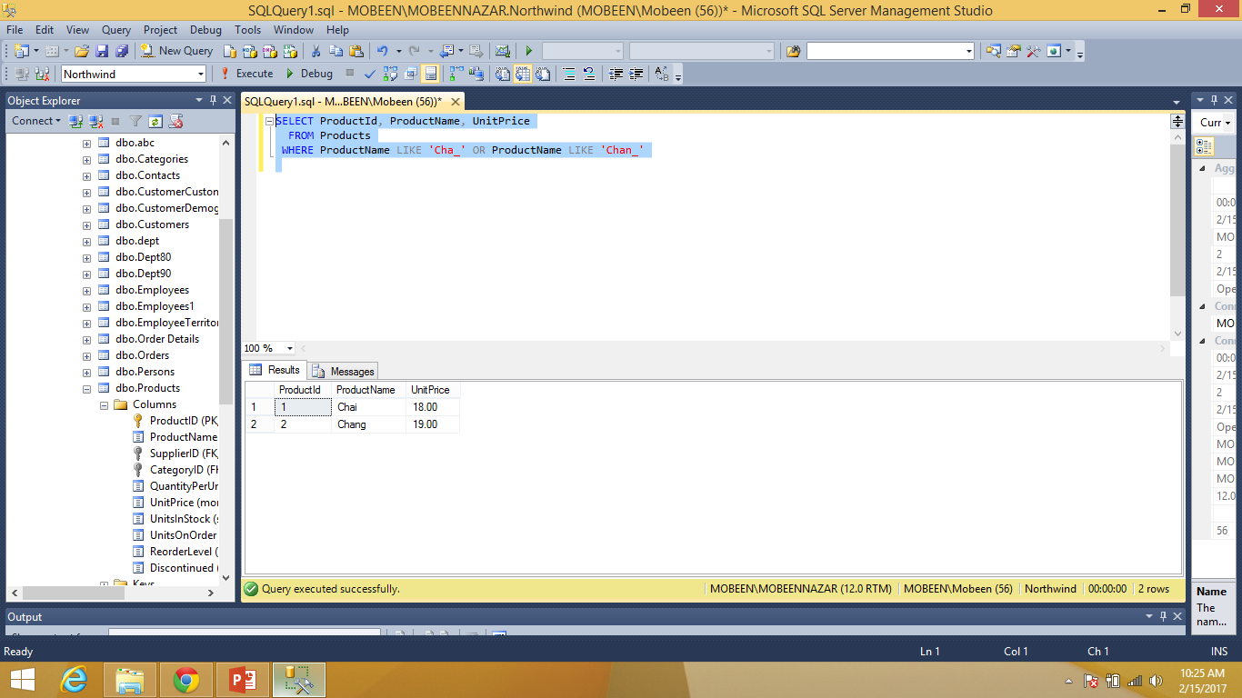
SQL Wildcards
SELECT ProductId, ProductName, UnitPrice FROM Products WHERE ProductName LIKE 'Cha_' OR ProductName LIKE 'Chan_'

Slide 6
SET OPERATERS IN SQL
SQL supports few Set operations which can be performed on the table data. These are used to get meaningful results from data stored in the table, under different special conditions.
We will cover 7 different types of SET operations, along with example:
UNION
UNION ALL
INTERSECT
EXCEPT
PRODUCT

Slide 7

Union Operation
UNION is used to combine the results of two or more SELECT statements. However it will eliminate duplicate rows from its resultset.
In case of union, number of columns and datatype must be same in both the tables, on which UNION operation is being applied.

Slide 8
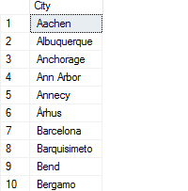
Union Operation
UNION Syntax
SELECT column_name(s) FROM table1
UNION
SELECT column_name(s) FROM table2;
Example:
SELECT City FROM Customers
Union
SELECT City FROM Suppliers

Slide 9

Union All Operation
The UNION operator selects only distinct values by default. To allow duplicate values, use UNION ALL
Syntax
SELECT column_name(s) FROM table1
UNION ALL
SELECT column_name(s) FROM table2

Slide 10
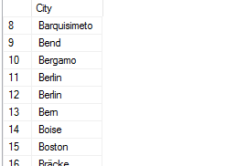
Union All Example
SELECT City FROM Customers
UNION ALL
SELECT City FROM Suppliers
ORDER BY City;

Slide 11

Intersect operation
Intersect operation is used to combine two SELECT statements, but it only retuns the records which are common from both SELECT statements.
In case of Intersect the number of columns and datatype must be same.

Slide 12
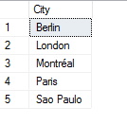
Intersect Syntax
SELECT column_name(s) FROM table1
intersect
SELECT column_name(s) FROM table2
Example
SELECT City FROM Customers
intersect
SELECT City FROM Suppliers

Slide 13

Except Operation
The SQL EXCEPT clause/operator is used to combine two SELECT statements and returns rows from the first SELECT statement that are not returned by the second SELECT statement.
This means EXCEPT returns only rows, which are not available in the second SELECT statement.
Syntax
SELECT column_name(s) FROM table1
Except
SELECT column_name(s) FROM table2

Slide 14
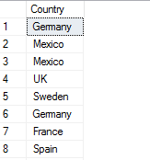
Except operation Example
SELECT Country FROM Customers
Except
SELECT Country from Suppliers

Slide 15
SQL Product Operation
The product of two tables is obtained by specifying a list of the tables to the SELECT command in its FROM clause. For example, the command
Syntax
SELECT * FROM table1, table2;
Example
Select * from customers, suppliers
will list all rows in the cross product of the two tables customers and suppliers.

Slide 16
SQL JOINS
A JOIN clause is used to combine rows from two or more tables, based on a related column between them.
SQL JOINS are used to retrieve data from multiple tables.
A SQL JOIN is performed whenever two or more tables are joined in a SQL statement.

Slide 17
LAB TASKS
1. Display Product’s name and their supplier’s name (ContactName), whose supplier’s name doesnot contain Dirk and there should be at most 7 characters in Product’s name.
2. Create a report showing order ID. OrderDate. EmployeeID, and the firstname and LastName of the associated Employee (Tables: Employees & Orders )
3. List distinct cities from of customers and suppliers, country must be Germany.
4. List all cities (duplicate values allowed)from of customers and suppliers
5. lists all customers and suppliers (ContactName, City, Country)

